Slide 1
Dynamical modelling of physiological systems
Alon Bar, Weizmann institute of science

Slide 2
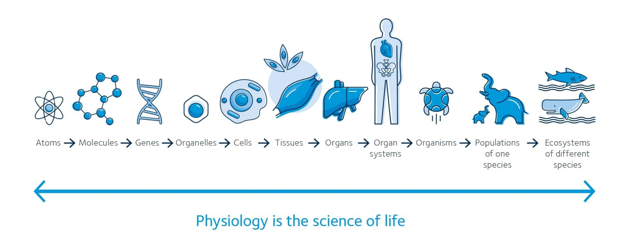
Our aim is to understand how physiological circuits work, and how they fails into a state of diseases
We will explore the amazing world of the human body!

Slide 3

Our aim is to understand how physiological circuits work, and how they fails into a state of diseases
We will explore the amazing world of the human body!
We will see how mathematics can help us make sense of the basic principles of human physiology and medicine.
Notes:
At the end of this workshop, I hope that you will have the basic tools to approach questions in system’s biology.
We will focus on physiology level circuits. But for the most, these basic tools can be generalized to other levels of biology – from molecules inside the cell (Go read Prof Uri Alon book)
To food chain and ecology.

Slide 4
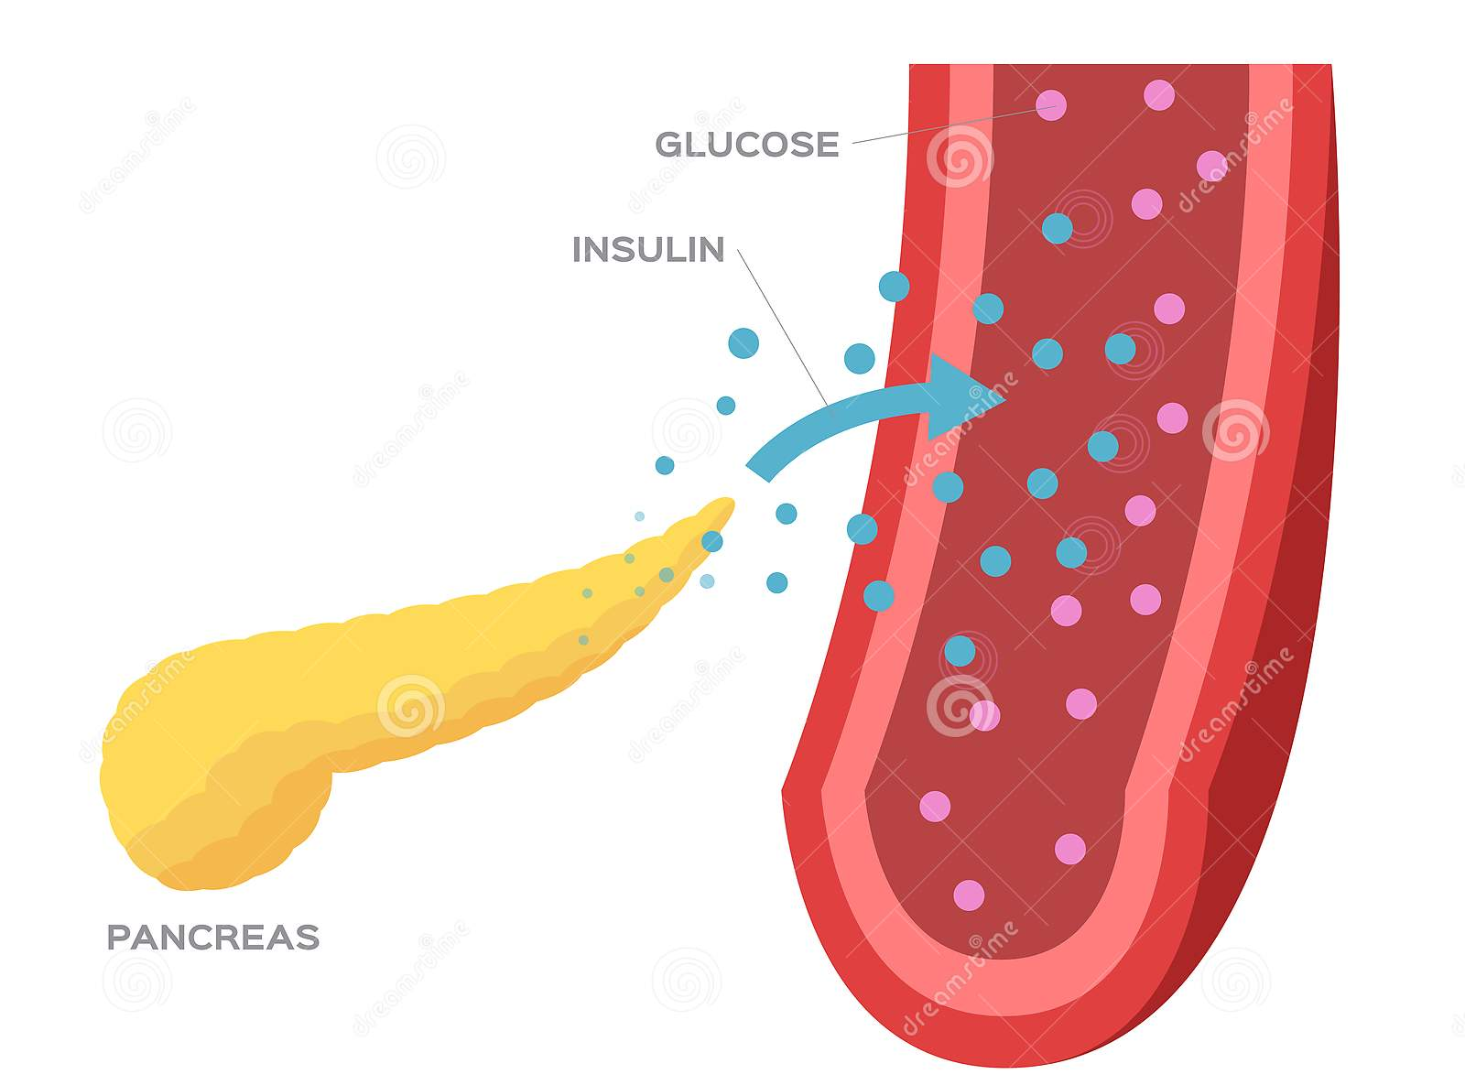
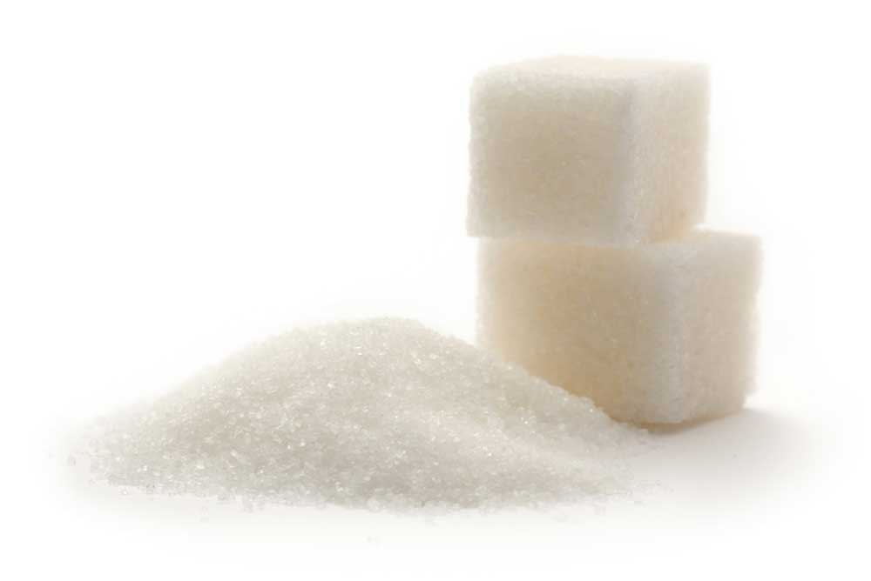
We will focus on the ‘hydrogen atom’ of physiological circuits: the glucose-insulin control circuit
It is the simplest and best-understood system which provides the conceptual tools to understand more complex cases
The glucose circuit is a good starting point because it highlights several important principles that apply to many other tissues.
It is also important medically, because its failure is the basis for diabetes, a disease afflicting about 10% of the world’s population

Slide 5
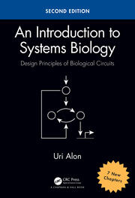


This workshop is based on Prof. Uri Alon’s book and courses
Notes:
Uri is my PhD supervisor, located at the Weizmann institute – MCB department.

Slide 6
*deep sigh of relief*

Slide 7
Agenda
Introduction to the glucose-insulin circuit
Beta-cell mass dynamics, compensation, and prediabetes
Type-2 diabetes and mutant resistance

Slide 8
1. Introduction to the glucose-insulin circuit
Notes:
Now we will go over the basic physiology of the glucose system. This is the time to ask questions about it.

Slide 9
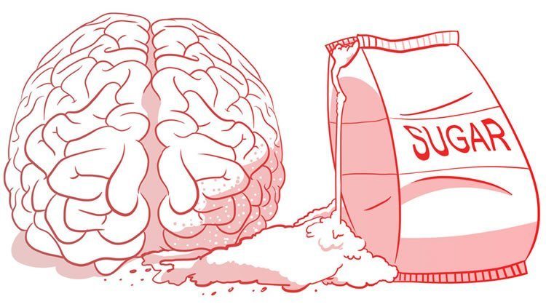
Glucose is an energy and carbon source for the cells in our body
Major fuel for the brain and for immune cells

Slide 10

Glucose concentration in the blood is maintained within a tight range around 5mM
Among healthy individuals, glucose blood concentrations vary by only about 20%.
Homeostasis - the ability of the body to keep important variables within a tight range.
The control of glucose under this tight range around 5mM is often called a “set-point”

Slide 11
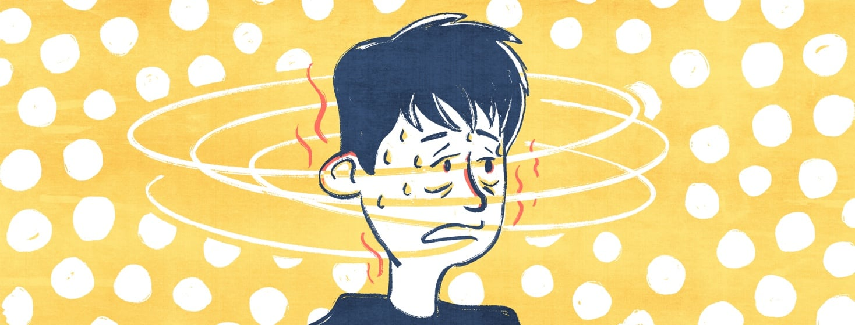
Unregulated blood glucose can be life threating
Prolonged low glucose, called hypoglycemia, can be fatal. The body switches to alternative energy sources such as ketone bodies which can cause blood acidity, which is potentially lethal.
Similarly, if glucose is too high, it starts sticking to blood vessels and nerves, damaging them. This can lead to heart attacks, kidney disease and blindness.

Slide 12
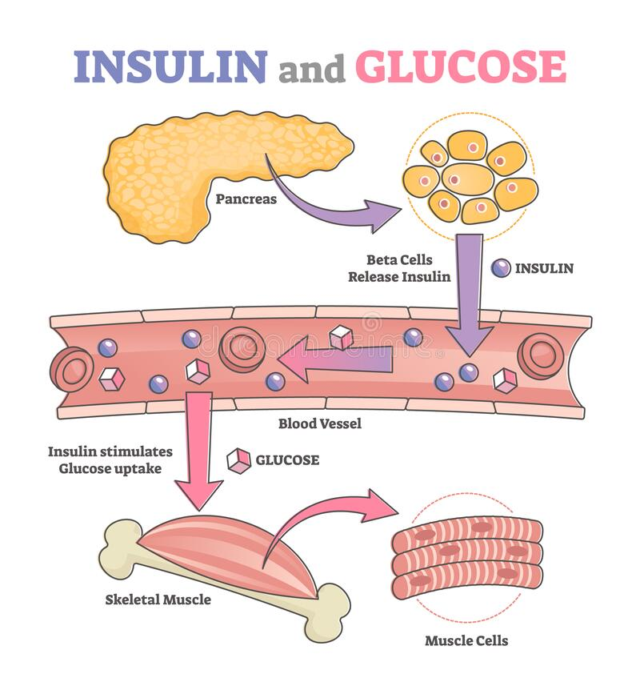
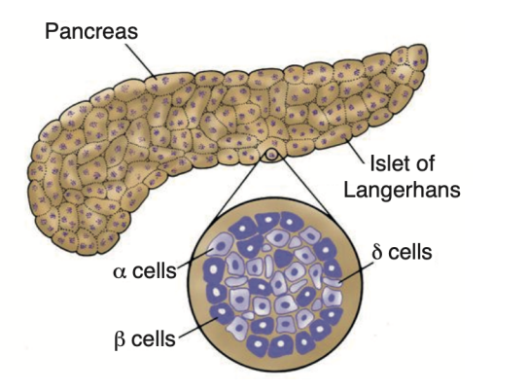
The control of blood glucose is achieved due to a feedback circuit involving the hormone insulin
Insulin is secreted by special cells in the pancreas called beta-cells.
Insulin acts to remove glucose from the blood, by allowing it to enter cells in the muscle, liver and fat where glucose is used or stored.

Slide 13
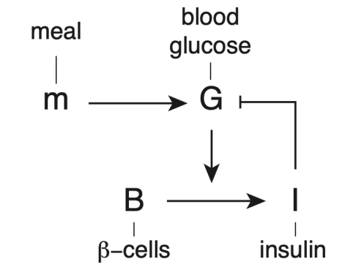
The control of blood glucose is achieved due to a feedback circuit involving the hormone insulin
Beta-cells sense glucose, and the more glucose around, the more insulin they secrete.
Insulin induces cells in the muscle and fat to take up glucose, and so blood glucose levels drop.
This is a negative feedback loop: more glucose, more insulin, and thus less glucose

Slide 14
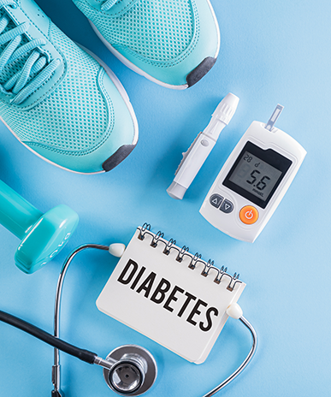
This control breaks in two well-known diseases
In type-1 diabetes (T1D), the immune system attacks beta cells and kills them. As a result, there is no insulin and cells cannot obtain the glucose they need.
In the much more common type-2 diabetes (T2D), beta-cells do not secrete enough insulin to remove glucose effectively. Glucose rises and over the years causes damage to the body.

Slide 15
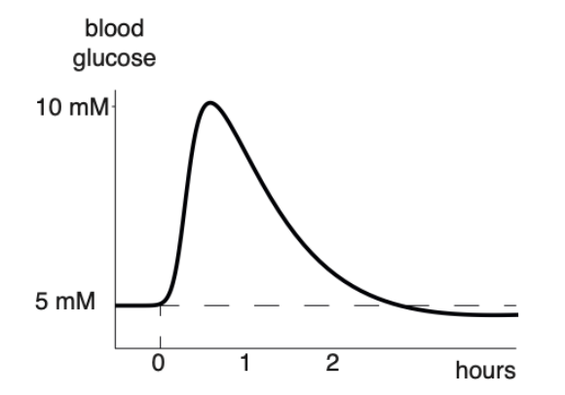
The entire glucose dynamics after a meal are tightly regulated
These dynamics are measured in a clinical test for diabetes, called the glucose tolerance test (GTT).
In GTT, you drink 75g of glucose, and measure blood glucose in the following two hours.
Glucose rises to about twice its basal level of 5mM, and then falls back to baseline in about 2 hours.

Slide 16
The circuit explains the shape of the GTT curve
In GTT, you drink 75g of glucose, and measure blood glucose in the following two hours.
Notes:
Ask someone to explain the curve using the diagram on the right

Slide 17
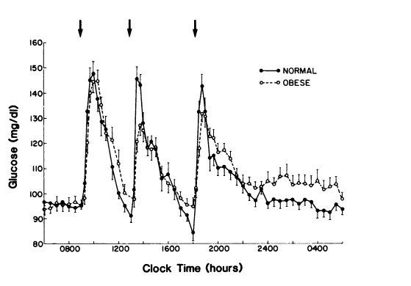
This rigorous control is achieved despite vast differences between people
Individuals can vary in weight, undergo the changes of pregnancy, vary in activity and diet. Yet most people most of the time have the same glucose set-points and dynamics!

Slide 18
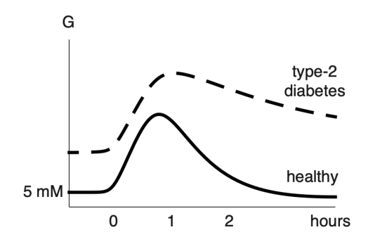
This rigorous control is achieved despite vast differences between people
Individuals can vary in weight, undergo the changes of pregnancy, vary in activity and diet. Yet most people most of the time have the same glucose set-points and dynamics!

Slide 19
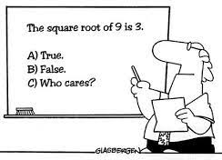
We have now completed a verbal introduction to this system
We want to go beyond verbal descriptions by adding equations. Equations can help us focus on important parameters and to generalize principles from one system to other systems.
Mathematical models for this circuit helped to define key parameters like insulin resistance. They also provide ways to estimate these parameters based on clinical measurements.
Notes:
developed since the 1970’s

Slide 20
We will use mathematical models in order to explain many of our observations:
How glucose is kept within a tight range?
How glucose set-point is kept around 5mM despite variation in parameters?
How glucose dynamics are tightly regulated despite variation in parameters?
How this regulation breaks into a state of disease?
Why this regulation breaks into a state of disease?

Slide 21
*deep sigh of relief*

Slide 22
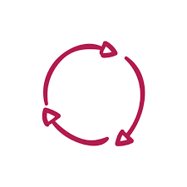
The minimal glucose-insulin model dynamic model of blood factors
Dynamic models are simplified representations of real-world entities, in equations or code.
A dynamic model is mechanistic, meaning that it is built by explicitly considering the processes that produce our observations.
They intended to mimic the essentials of the study system and describe how system properties change over time.
Dynamic models allow us to examine relationships that couldn’t be sorted out by purely experimental methods, and to make forecasts that cannot be made strictly by extrapolating from data.
Using this approach, we can aim to explain why variables are related the way they are.

Slide 23
The minimal glucose-insulin model a system of two differential equations
Our main aim is to understand how and why blood glucose changes over time, and its effects on our body over time.
For this purpose, we use two differential equations.
Differential equation usually describes how something changes over time by considering the processes that affect it.
In this model, we have a system of two differential equations
one for glucose and one for insulin

Slide 24
The differential equation for glucose is made from its production and removal
$\frac{dG}{dt}$ = Rate of change of glucose = production-removal

Slide 25
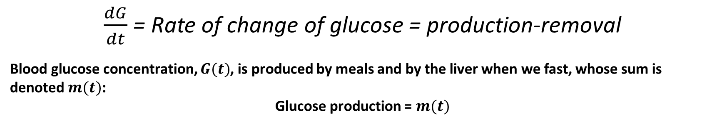
The differential equation for glucose is made from its production and removal
$\frac{dG}{dt}$ = Rate of change of glucose = production-removal
Blood glucose concentration, $G(t)$, is produced by meals and by the liver when we fast, whose sum is denoted $m(t)$:
Glucose production = $m(t)$

Slide 26
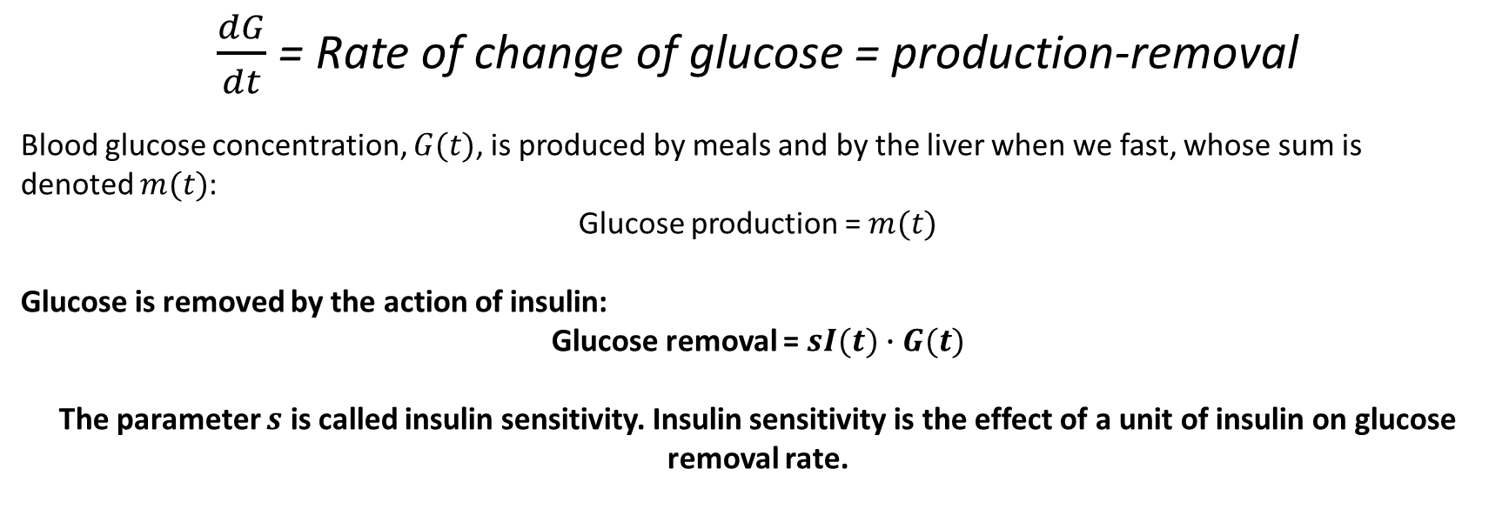
The differential equation for glucose is made from its production and removal
$\frac{dG}{dt}$ = Rate of change of glucose = production-removal
Blood glucose concentration, $G(t)$, is produced by meals and by the liver when we fast, whose sum is denoted $m(t)$:
Glucose production = $m(t)$
Glucose is removed by the action of insulin:
Glucose removal =$sI(t)∙G(t)$
The parameter $s$ is called insulin sensitivity. Insulin sensitivity is the effect of a unit of insulin on glucose removal rate.

Slide 27
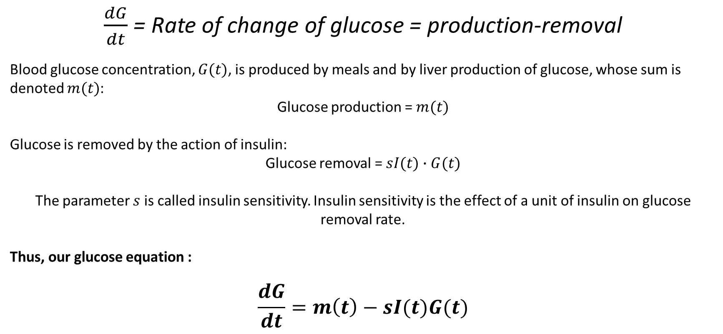
The differential equation for glucose is made from its production and removal
$\frac{dG}{dt}$ = Rate of change of glucose = production-removal
Blood glucose concentration, $G(t)$, is produced by meals and by liver production of glucose, whose sum is denoted $m(t)$:
Glucose production = $m(t)$
Glucose is removed by the action of insulin:
Glucose removal =$sI(t)∙G(t)$
The parameter $s$ is called insulin sensitivity. Insulin sensitivity is the effect of a unit of insulin on glucose removal rate.
Thus, our glucose equation :
$$\frac{dG}{dt}=m\left(t\right)−sI(t)G(t)$$

Slide 28
We will use similar approach for the insulin equation
$\frac{dI}{dt}$ = Rate of change of insulin = production-removal

Slide 29
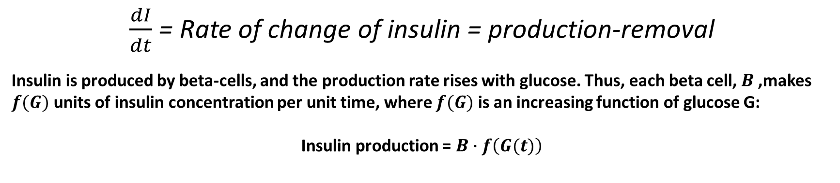
We will use similar approach for the insulin equation
$\frac{dI}{dt}$ = Rate of change of insulin = production-removal
Insulin is produced by beta-cells, and the production rate rises with glucose. Thus, each beta cell, $B$,makes $f(G)$ units of insulin concentration per unit time, where $f(G)$ is an increasing function of glucose G:
Insulin production = $B∙f\left(G(t)\right)$

Slide 30
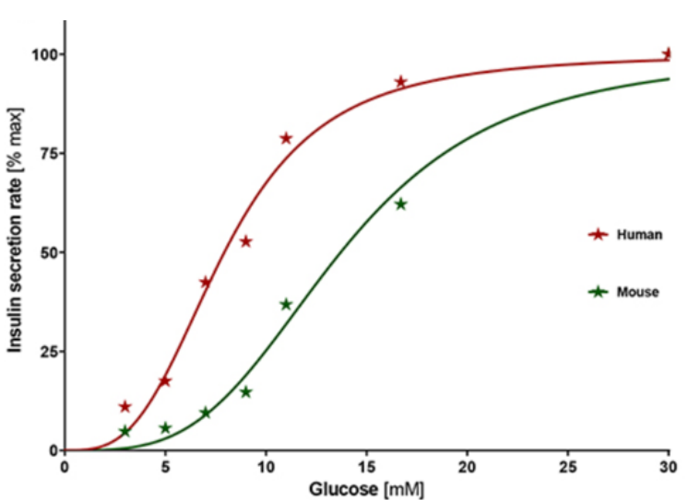

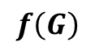
We will use similar approach for the insulin equation
$\frac{dI}{dt}$ = Rate of change of insulin = production-removal
Insulin is produced by beta-cells, and the production rate rises with glucose. Thus, each beta cell, $B$,makes $f(G)$ units of insulin concentration per unit time, where $f(G)$ is an increasing function of glucose G:
Insulin production = $B∙f\left(G(t)\right)$
From experimental measurements, we can observe that $f\left(G\right)$ is S-shaped
$$f\left(G\right)$$

Slide 31
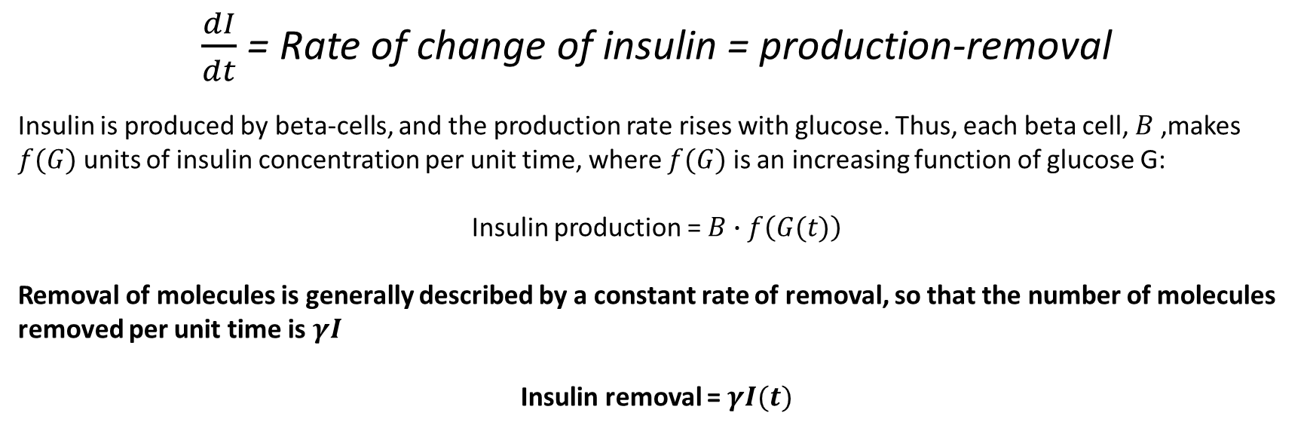
We will use similar approach for the insulin equation
$\frac{dI}{dt}$ = Rate of change of insulin = production-removal
Insulin is produced by beta-cells, and the production rate rises with glucose. Thus, each beta cell, $B$,makes $f(G)$ units of insulin concentration per unit time, where $f(G)$ is an increasing function of glucose G:
Insulin production = $B∙f\left(G(t)\right)$
Removal of molecules is generally described by a constant rate of removal, so that the number of molecules removed per unit time is $γI$
Insulin removal = $γI(t)$

Slide 32
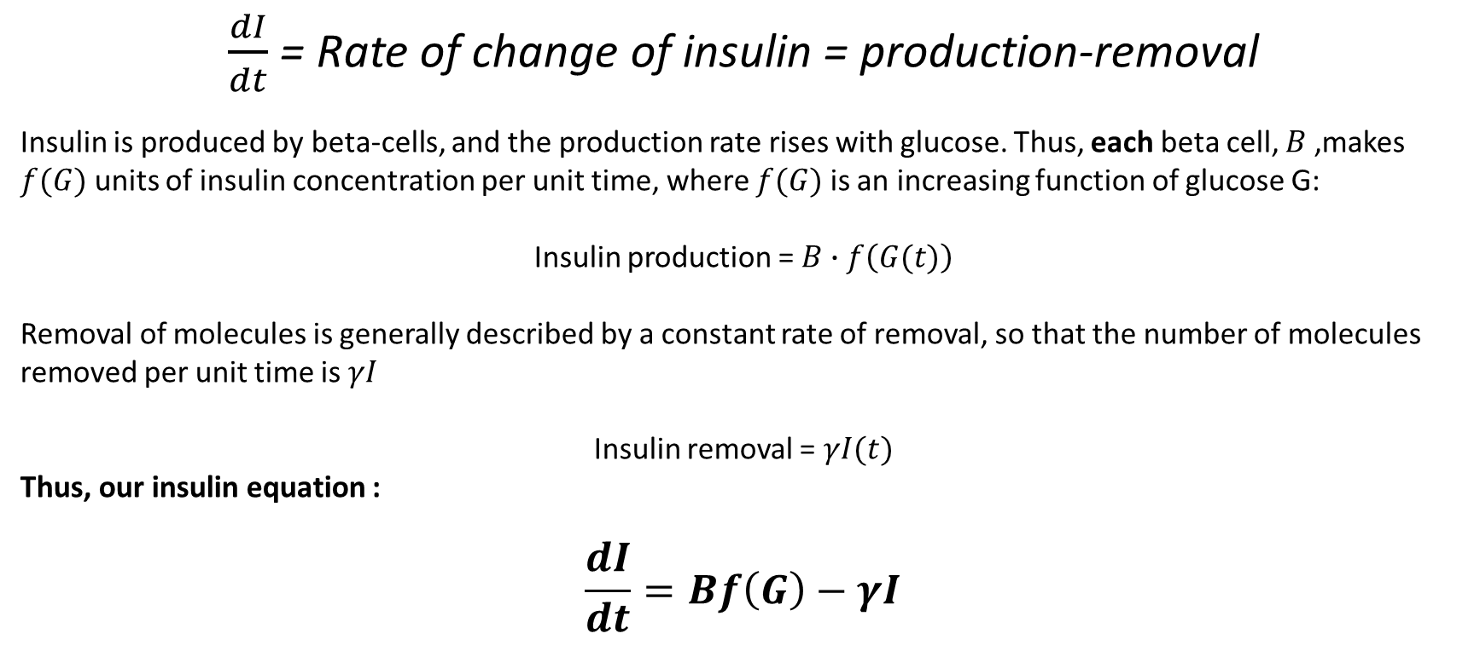
We will use similar approach for the insulin equation
$\frac{dI}{dt}$ = Rate of change of insulin = production-removal
Insulin is produced by beta-cells, and the production rate rises with glucose. Thus, each beta cell, $B$,makes $f(G)$ units of insulin concentration per unit time, where $f(G)$ is an increasing function of glucose G:
Insulin production = $B∙f\left(G(t)\right)$
Removal of molecules is generally described by a constant rate of removal, so that the number of molecules removed per unit time is $γI$
Insulin removal = $γI(t)$
Thus, our insulin equation :
$$\frac{dI}{dt}=Bf\left(G\right)−γI$$

Slide 33
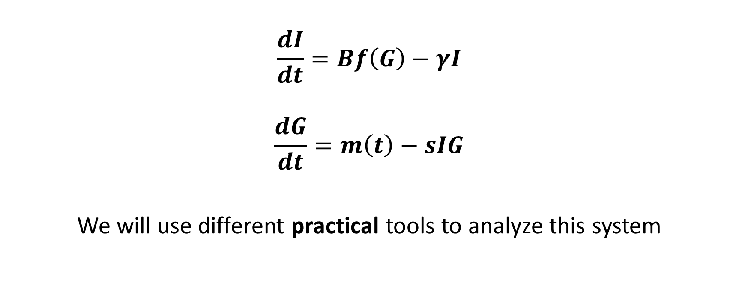
We now have a working model of the glucose-insulin circuit.
$$\frac{dI}{dt}=Bf\left(G\right)−γI$$
$$\frac{dG}{dt}=m\left(t\right)−sIG$$
We will use different practical tools to analyze this system

Slide 34
*deep sigh of relief*

Slide 35
Exercise 1a – introduction to python, notebooks and sympy

Slide 36
Exercise 1b – expressing our equations in python

Slide 37
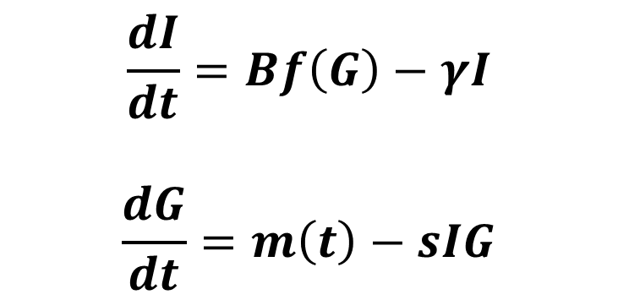
With our model of the glucose-insulin circuit, can we explain how glucose is being kept within a tight range?
Can our model guarantee a stable value for glucose?
$$\frac{dI}{dt}=Bf\left(G\right)−γI$$
$$\frac{dG}{dt}=m\left(t\right)−sIG$$

Slide 38
With our model of the glucose-insulin circuit, can we explain how glucose is being kept within a tight range?
Can our model guarantee a stable value for glucose?
In mathematics, this value is called a steady-state
When glucose and insulin are at the steady state, their rate of change is zero. They will not change.
$$\frac{dI}{dt}=Bf\left(G\right)−γI$$
$$\frac{dG}{dt}=m\left(t\right)−sIG$$

Slide 39
With our model of the glucose-insulin circuit, can we explain how glucose is being kept within a tight range?
Can our model guarantee a stable value for glucose?
In mathematics, this value is called a steady-state
When glucose and insulin are at the steady state, their rate of change is zero. They will not change.
Can our model guarantee that the steady-state will be around 5mM?
To answer this, we will use a graphical tool to analyze the steady-state of the system
$$\frac{dI}{dt}=Bf\left(G\right)−γI$$
$$\frac{dG}{dt}=m\left(t\right)−sIG$$

Slide 40
Graphical analysis of the model using the phase portrait
The phase portrait has two axes, one for each of the variables, in our case - insulin and glucose.
To draw it, we will have to imagine two experiments
The idea is to break the feedback loop into two arms. Study each arm separately, and then put them back together.
Insulin
Glucose

Slide 41
The first arm of the feedback loop describes how insulin removes glucose.
Insulin
Glucose

Slide 42
The first arm of the feedback loop describes how insulin removes glucose.
Imagine clamping blood insulin at a given level and waiting until glucose settles down to its steady state. At each level of insulin, you record the steady-state level of glucose.
Insulin
Glucose

Slide 43
The first arm of the feedback loop describes how insulin removes glucose.
Imagine clamping blood insulin at a given level and waiting until glucose settles down to its steady state. At each level of insulin, you record the steady-state level of glucose.
If we hold insulin at high levels, glucose will be low
Insulin
Glucose

Slide 44
The first arm of the feedback loop describes how insulin removes glucose.
Imagine clamping blood insulin at a given level and waiting until glucose settles down to its steady state. At each level of insulin, you record the steady-state level of glucose.
Insulin
If we hold insulin at low levels, glucose will be high
Glucose

Slide 45
The first arm of the feedback loop describes how insulin removes glucose.
Imagine clamping blood insulin at a given level and waiting until glucose settles down to its steady state. At each level of insulin, you record the steady-state level of glucose.
Insulin
We repeat this for many values of insulin
Glucose

Slide 46
The first arm of the feedback loop describes how insulin removes glucose.
Imagine clamping blood insulin at a given level and waiting until glucose settles down to its steady state. At each level of insulin, you record the steady-state level of glucose.
This process forms a line over the phase portrait – the glucose line.
Insulin
Glucose

Slide 47
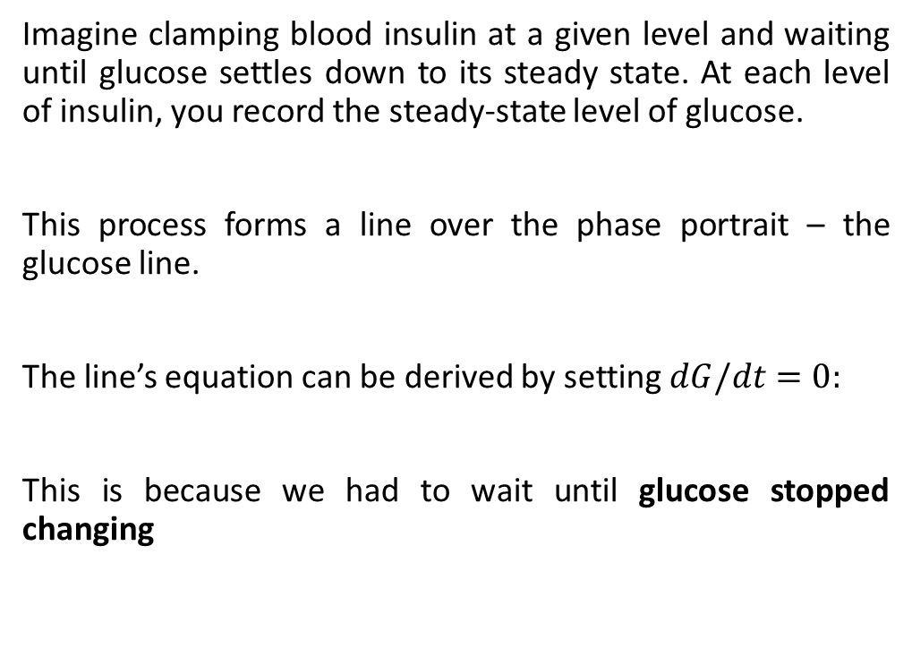
The first arm of the feedback loop describes how insulin removes glucose.
Imagine clamping blood insulin at a given level and waiting until glucose settles down to its steady state. At each level of insulin, you record the steady-state level of glucose.
This process forms a line over the phase portrait – the glucose line.
The line’s equation can be derived by setting $dG/dt$ $=0$:
This is because we had to wait until glucose stopped changing
Insulin
Glucose

Slide 48
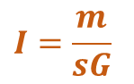
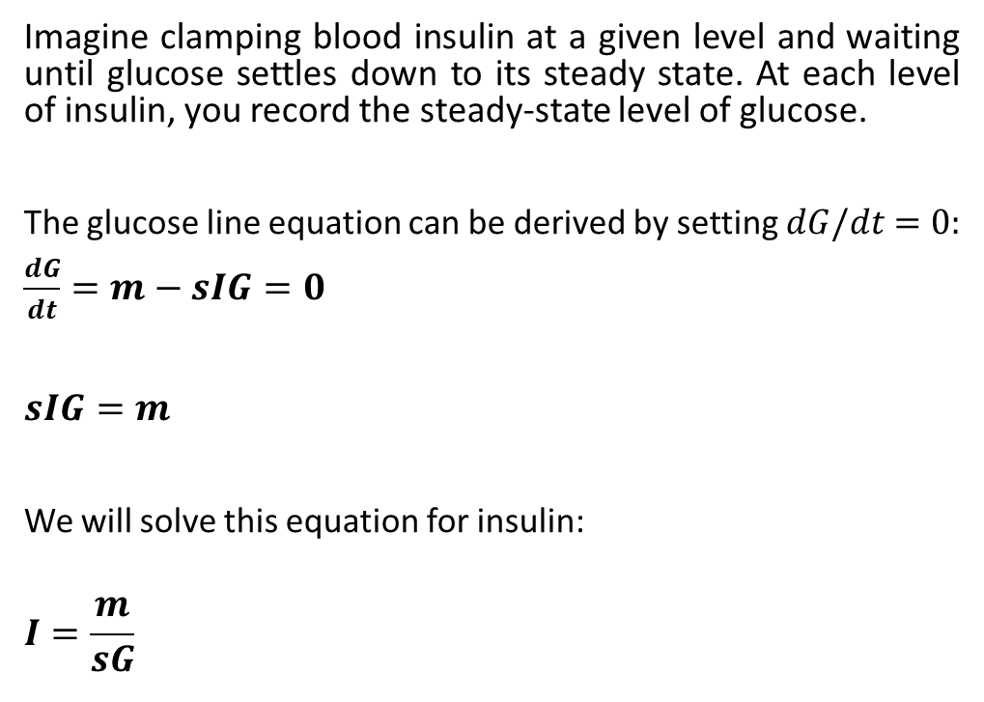
The first arm of the feedback loop describes how insulin removes glucose.
Imagine clamping blood insulin at a given level and waiting until glucose settles down to its steady state. At each level of insulin, you record the steady-state level of glucose.
The glucose line equation can be derived by setting $dG/dt$ $=0$:
$\frac{dG}{dt}=m−sIG=0$
$sIG=m$
We will solve this equation for insulin:
$$I=\frac{m}{sG}$$
$$I=\frac{m}{sG}$$
Insulin
Glucose

Slide 49
*deep sigh of relief*

Slide 50
The second arm describes how glucose induces beta-cells to make insulin
Insulin
Glucose

Slide 51
The second arm describes how glucose induces beta cells to make insulin
One experiment to measure this arm uses intravenous injection of glucose to ‘clamp’ blood glucose to a given value. Then, one allows insulin to reach steady-state and measures its concentration.
Insulin
Glucose

Slide 52
The second arm describes how glucose induces beta cells to make insulin
One experiment to measure this arm uses intravenous injection of glucose to ‘clamp’ blood glucose to a given value. Then, one allows insulin to reach steady-state and measures its concentration.
If we hold glucose at high levels, insulin will be high
Insulin
If we hold glucose at low levels, insulin will be low
Glucose

Slide 53
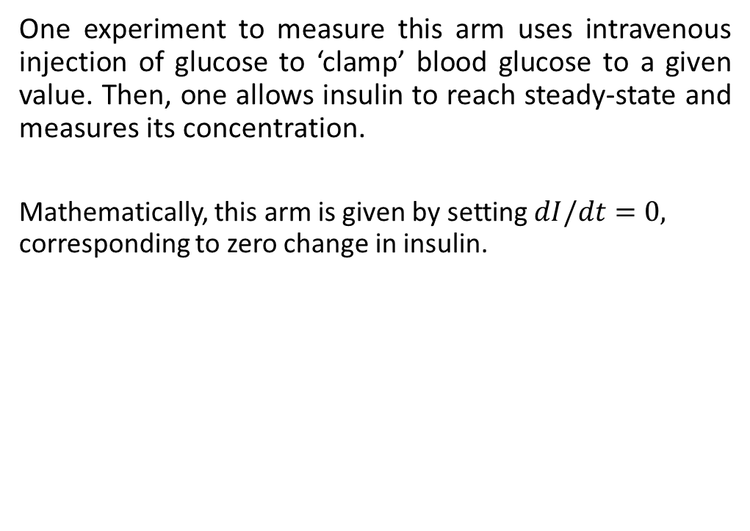
The second arm describes how glucose induces beta cells to make insulin
One experiment to measure this arm uses intravenous injection of glucose to ‘clamp’ blood glucose to a given value. Then, one allows insulin to reach steady-state and measures its concentration.
Mathematically, this arm is given by setting $dI/dt=0,$ corresponding to zero change in insulin.
If we hold glucose at high levels, insulin will be high
Insulin
If we hold glucose at low levels, insulin will be low
Glucose

Slide 54
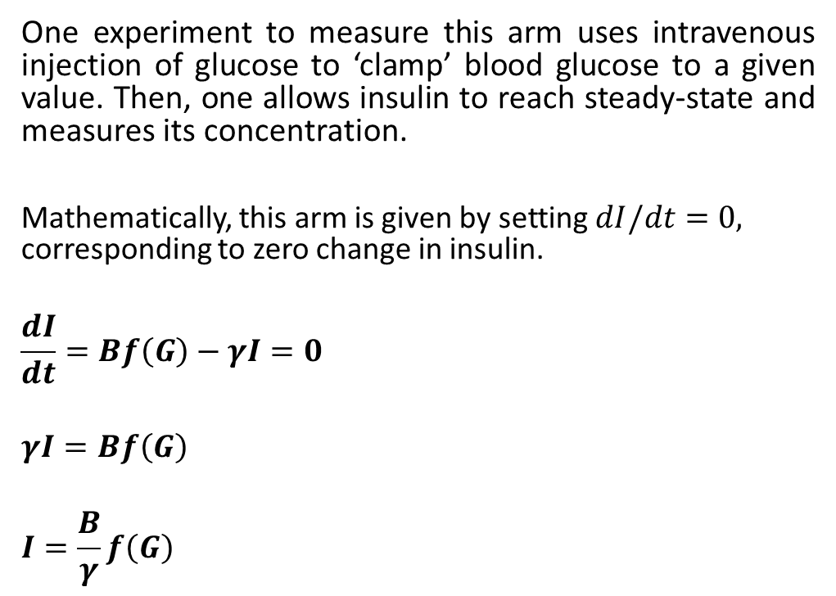
The second arm describes how glucose induces beta cells to make insulin
One experiment to measure this arm uses intravenous injection of glucose to ‘clamp’ blood glucose to a given value. Then, one allows insulin to reach steady-state and measures its concentration.
Mathematically, this arm is given by setting $dI/dt=0,$ corresponding to zero change in insulin.
$$\frac{dI}{dt}=Bf\left(G\right)−γI=0$$
$$γI=Bf\left(G\right)$$
$$I=\frac{B}{γ}f\left(G\right)$$
If we hold glucose at high levels, insulin will be high
Insulin
If we hold glucose at low levels, insulin will be low
Glucose

Slide 55
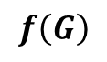
The second arm describes how glucose induces beta cells to make insulin
One experiment to measure this arm uses intravenous injection of glucose to ‘clamp’ blood glucose to a given value. Then, one allows insulin to reach steady-state and measures its concentration.
Mathematically, this arm is given by setting $dI/dt=0,$ corresponding to zero change in insulin.
$$\frac{dI}{dt}=Bf\left(G\right)−γI=0$$
$$γI=Bf\left(G\right)$$
$$I=\frac{B}{γ}f\left(G\right)$$
If we hold glucose at high levels, insulin will be high
Insulin
If we hold glucose at low levels, insulin will be low
Glucose
$$f\left(G\right)$$

Slide 56
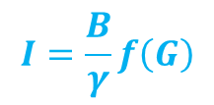
The second arm describes how glucose induces beta cells to make insulin
One experiment to measure this arm uses intravenous injection of glucose to ‘clamp’ blood glucose to a given value. Then, one allows insulin to reach steady-state and measures its concentration.
Mathematically, this arm is given by setting $dI/dt=0,$ corresponding to zero change in insulin.
$$\frac{dI}{dt}=Bf\left(G\right)−γI=0$$
$$γI=Bf\left(G\right)$$
$$I=\frac{B}{γ}f\left(G\right)$$
$$I=\frac{B}{γ}f\left(G\right)$$
Insulin
Glucose
$$f\left(G\right)$$

Slide 57
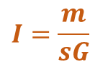

The phase portrait can help us arrive at conclusions even if we don’t know the mathematical functions or parameters in the model and hence the precise shapes of the lines.
Glucose line
$$I=\frac{m}{sG}$$
Insulin
Insulin line
$$I=\frac{B}{γ}f\left(G\right)$$
Glucose
No matter what the exact shape of the curves, we know that one curve must increase – glucose induces insulin production—and the other curve must decrease – insulin removes glucose.

Slide 58
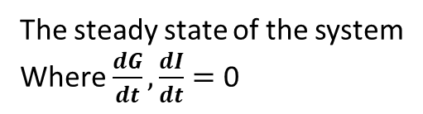
The phase portrait can help us arrive at conclusions even if we don’t know the mathematical functions or parameters in the model and hence the precise shapes of the lines.
Glucose line
Insulin
Insulin line
The steady state of the system
Where $\frac{dG}{dt},\frac{dI}{dt}=$ 0
Glucose
No matter what the exact shape of the curves, we know that one curve must increase – glucose induces insulin production—and the other curve must decrease – insulin removes glucose.
This guarantees a steady state where the two curves intersect!

Slide 59
The phase portrait can help us arrive at conclusions even if we don’t know the mathematical functions or parameters in the model and hence the precise shapes of the lines.
Glucose line
Insulin
Insulin line
The steady state of the system
Where $\frac{dG}{dt},\frac{dI}{dt}=$ 0
Glucose
The value should be 5mM
No matter what the exact shape of the curves, we know that one curve must increase – glucose induces insulin production—and the other curve must decrease – insulin removes glucose.
This guarantees a steady state where the two curves intersect!

Slide 60
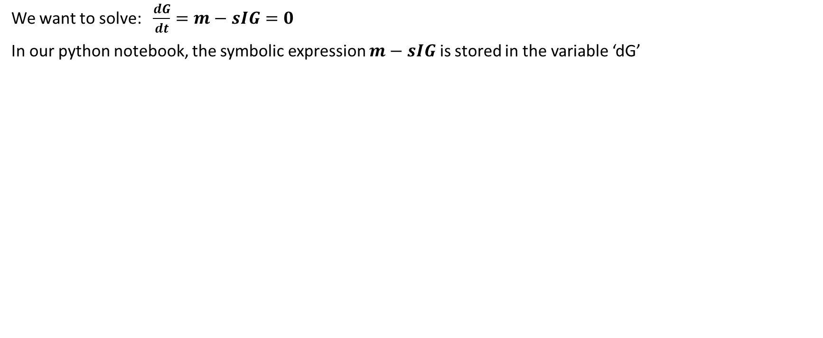

Using python to find the solution for $\frac{dG}{dt}=0$
We want to solve: $\frac{dG}{dt}=m−sIG=0$
In our python notebook, the symbolic expression $m−sIG$ is stored in the variable ‘dG’

Slide 61
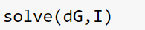
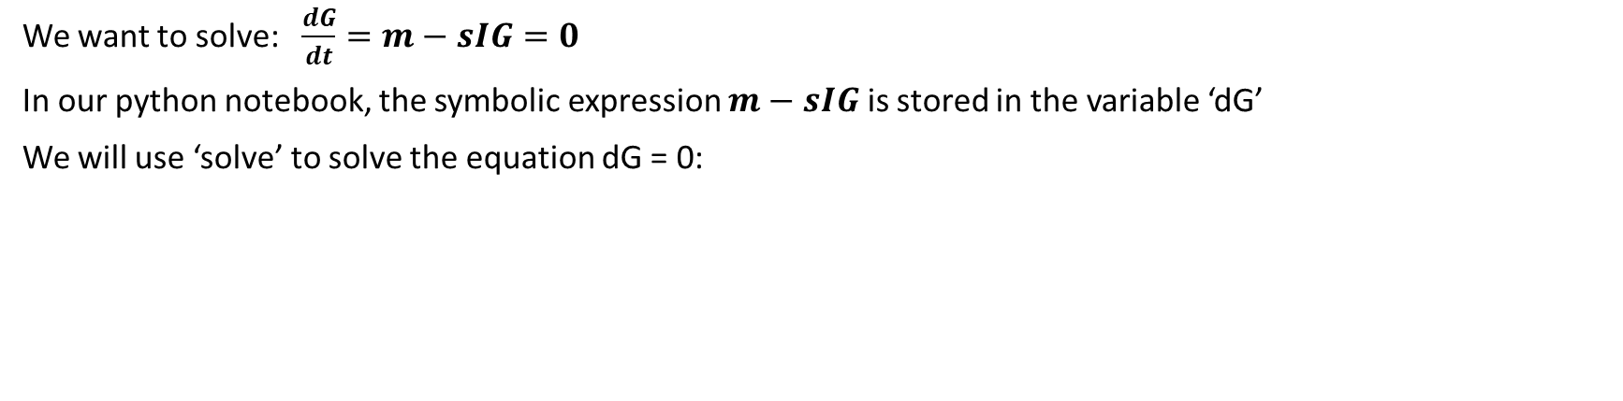
Using python to find the solution for $\frac{dG}{dt}=0$
We want to solve: $\frac{dG}{dt}=m−sIG=0$
In our python notebook, the symbolic expression $m−sIG$ is stored in the variable ‘dG’
We will use ‘solve’ to solve the equation dG = 0:
The first argument is the expression we equate to zero
The second argument is variable we wish to solve for

Slide 62
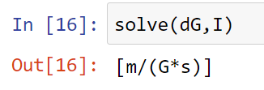
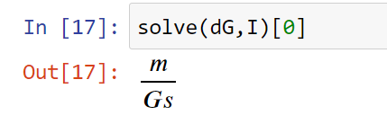
Using python to find the solution for $\frac{dG}{dt}=0$
We want to solve: $\frac{dG}{dt}=m−sIG=0$
In our python notebook, the symbolic expression $m−sIG$ is stored in the variable ‘dG’
We will use ‘solve’ to solve the equation dG = 0:
The first argument is the expression we equate to zero
The second argument is variable we wish to solve for
‘solve’ returns a list with all the valid solutions.
Here we find a single solution:
If we know that there is only one solution,
we can ask solve to return the only solution in the list:

Slide 63

Exercise 1c – solve $\frac{dI}{dt}=0$ in python

Slide 64

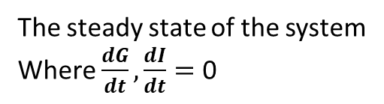
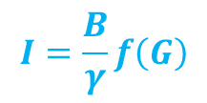
We can use the phase portrait to estimate the effect of each parameter on the steady-state
Glucose line
$$I=\frac{m}{sG}$$
Insulin
Insulin line
$$I=\frac{B}{γ}f\left(G\right)$$
The steady state of the system
Where $\frac{dG}{dt},\frac{dI}{dt}=$ 0
Glucose

Slide 65
Whiteboard exercise
Use pen and paper, draw the phase portrait
Compare different values for each parameter to see its effect:
What happens to the glucose line?
What happens to insulin line?
What happens to glucose steady state?
What happens to insulin steady state?

Slide 66
Can we use our model to quantitatively describe the steady state?
Glucose line
$$I=\frac{m}{sG}$$
Insulin
Insulin line
$$I=\frac{B}{γ}f\left(G\right)$$
The steady state of the system
Where $\frac{dG}{dt},\frac{dI}{dt}=$ 0
Glucose

Slide 67
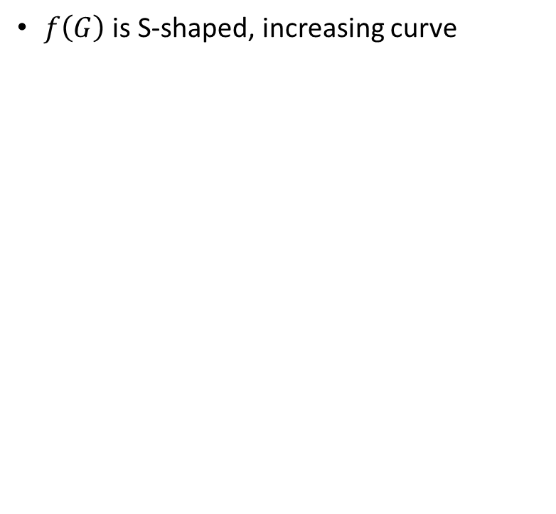

We can use an approximation of $f\left(G\right)$ in order to simplify system
$f\left(G\right)$ is S-shaped, increasing curve

Slide 68
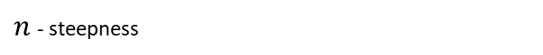
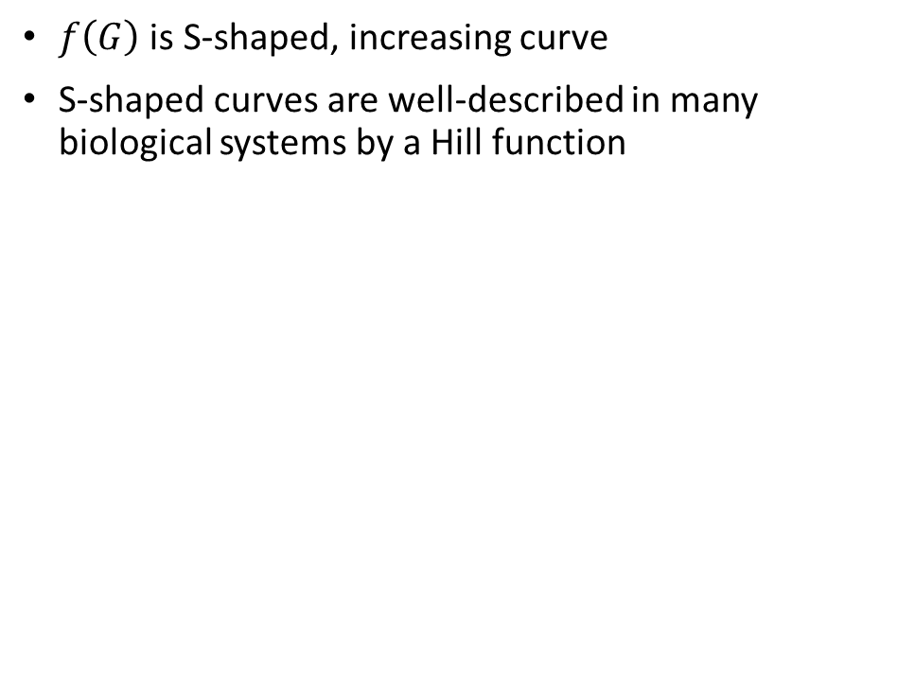
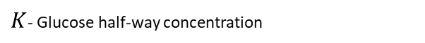
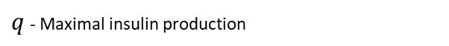
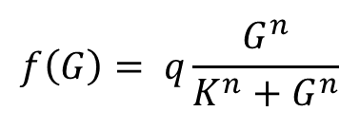
We can use an approximation of $f\left(G\right)$ in order to simplify system
$f\left(G\right)$ is S-shaped, increasing curve
S-shaped curves are well-described in many biological systems by a Hill function
$$f\left(G\right)= q\frac{G^{n}}{K^{n}+G^{n}}$$
$q$ - Maximal insulin production
$K$- Glucose half-way concentration
$n$ - steepness

Slide 69
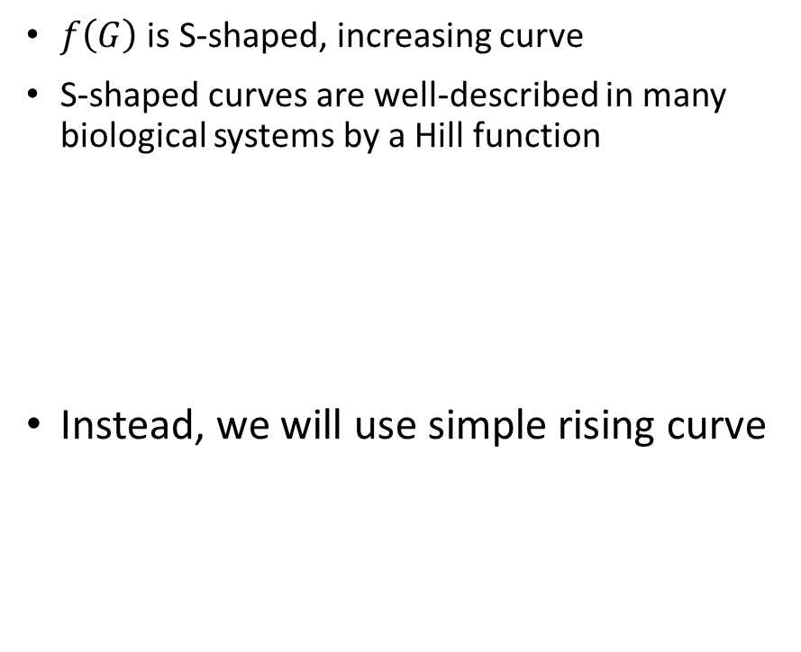
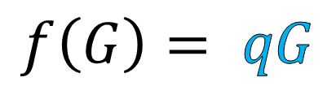
We can use an approximation of $f\left(G\right)$ in order to simplify system
$f\left(G\right)$ is S-shaped, increasing curve
S-shaped curves are well-described in many biological systems by a Hill function
Instead, we will use simple rising curve
$$f\left(G\right)= q\frac{G^{n}}{K^{n}+G^{n}}$$
$q$ - Maximal insulin production
$K$- Glucose half-way concentration
$n$ - steepness
$$f\left(G\right)= qG$$

Slide 70
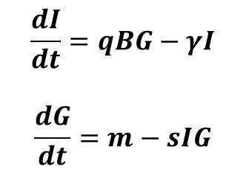
Simple approximations usually yield simple solution, that we can understand easily
Using this approximation, we can easily calculate the steady state of the system
$$\frac{dI}{dt}=qBG−γI$$
$$\frac{dG}{dt}=m−sIG$$

Slide 71

Simple approximations usually yield simple solution, that we can understand easily
Using this approximation, we can easily calculate the steady state of the system
$$\frac{dI}{dt}=qBG−γI$$
$$\frac{dG}{dt}=m−sIG$$
$$0=qBG−γI$$
$$0=m−sIG$$

Slide 72

Simple approximations usually yield simple solution, that we can understand easily
Using this approximation, we can easily calculate the steady state of the system
$$\frac{dI}{dt}=qBG−γI$$
$$\frac{dG}{dt}=m−sIG$$
$$0=qBG−γI$$
$$0=m−sIG$$
$$I=\frac{m}{sG}$$

Slide 73

Simple approximations usually yield simple solution, that we can understand easily
Using this approximation, we can easily calculate the steady state of the system
$$\frac{dI}{dt}=qBG−γI$$
$$\frac{dG}{dt}=m−sIG$$
$$0=qBG−γI$$
$$0=m−sIG$$
$$0=qBG−\frac{γm}{sG}$$
$$I=\frac{m}{sG}$$

Slide 74

Simple approximations usually yield simple solution, that we can understand easily
Using this approximation, we can easily calculate the steady state of the system
$$\frac{dI}{dt}=qBG−γI$$
$$\frac{dG}{dt}=m−sIG$$
$$0=qBG−γI$$
$$0=m−sIG$$
$$0=qBG−\frac{γm}{sG}$$
$$0=sqBG^{2}−γm$$
$$I=\frac{m}{sG}$$

Slide 75



Simple approximations usually yield simple solution, that we can understand easily
Using this approximation, we can easily calculate the steady state of the system
$$\frac{dI}{dt}=qBG−γI$$
$$\frac{dG}{dt}=m−sIG$$
$$0=qBG−γI$$
$$0=m−sIG$$
$$0=qBG−\frac{γm}{sG}$$
$$0=sqBG^{2}−γm$$
$$sqBG^{2}=γm$$
$G^{2}=\frac{γm}{sqB}$
$$I=\frac{m}{sG}$$
$G=\sqrt{\frac{γm}{sqB}}$

Slide 76


Exercise 1d
Using sympy, find the steady state of the simplified system:
$$\frac{dI}{dt}=qBG−γI$$
$$\frac{dG}{dt}=m−sIG$$

Slide 77
Exercise 1e – analyzing the phase portrait using python

Slide 78
The equations provide a steady state for glucose
Next, we will see how these equations dynamically reach this steady state
We use the equations to simulate the glucose tolerance test.

Slide 79

To simulate GTT, we will use “Euler method” for numerical integration
Simple and intuitive approach to simulate differential equations:
First we give numerical values for the parameters
We choose total time to simulate – ($T$)
We divide this time into small jumps – ($dt$)
We start with initial values for Glucose and Insulin ($G(0),I(0))$
For every $dt$:
numerically compute $dG,dI$
Update Glucose and Insulin values
$G\left(t+dt\right)=G\left(t\right)+dG∗dt$
$I\left(t+dt\right)=I\left(t\right)+dI∗dt$

Slide 80

To simulate GTT, we will use “Euler method” for numerical integration
Define the time-course of the simulation

Slide 81
To simulate GTT, we will use “Euler method” for numerical integration
We set the initial condition to be the steady state of the system

Slide 82
To simulate GTT, we will use “Euler method” for numerical integration
We make an empty list to store the result

Slide 83

To simulate GTT, we will use “Euler method” for numerical integration
To simulate GTT, we rise glucose production for 30 minutes
For every time step, we compute $dG,dI$ and update the values for $G,I$

Slide 84
Exercise 1f – simulate GTT in python

Slide 85

Most people with obesity, which all have low $s$, have normal 5mM glucose and GTT dynamics.
No model based on the description of the system we studied so far can explain this!

Slide 86
*deep sigh of relief*

Slide 87
2. Beta-cell mass dynamics, compensation, and prediabetes

Slide 88

Robustness must involve additional processes beyond the minimal model’s glucose-insulin feedback loop
The way that the body compensates for low insulin sensitivity is by making more insulin:
Each beta-cell upregulates its insulin production capacity.
Then, there is an increase in the number and mass of beta cells due to both hyperplasia—more cells, and hypertrophy—bigger cells.
For example, healthy obese people are insulin resistant. They have more and larger beta cells than lean individuals. This extra secretion compensates for insulin resistance.

Slide 89
To explain this compensation, we need to extend the minimal model by adding an equation to describe how beta-cell total mass, B, can change
Cell populations dynamics are unlike the dynamics of protein concentrations inside cells or molecules in the blood.

Slide 90


To explain this compensation, we need to extend the minimal model by adding an equation to describe how beta-cell total mass, B, can change
Cell populations dynamics are unlike the dynamics of protein concentrations inside cells or molecules in the blood.
All cells come from cells, and thus proliferation is intrinsically autocatalytic. The change in total cell mass B is the difference between proliferation and removal rates:
$$dB/dt=pB−rB=(p−r)B=μB.$$

Slide 91

To explain this compensation, we need to extend the minimal model by adding an equation to describe how beta-cell total mass, B, can change
Cell populations dynamics are unlike the dynamics of protein concentrations inside cells or molecules in the blood.
All cells come from cells, and thus proliferation is intrinsically autocatalytic. The change in total cell mass B is the difference between proliferation and removal rates:
$$dB/dt=pB−rB=(p−r)B=μB.$$
If proliferation exceeds removal, growth rate is positive and total cell mass rises exponentially. On the other hand, if removal exceeds proliferation, growth rate is negative, and cell numbers exponentially decay to zero.
Cells live on a knife’s edge. It is hard to keep total cell mass constant over time. This is known as the problem of organ size control.

Slide 92
To keep cell numbers constant, we need feedback control to balance proliferation and removal
Organ size control of beta-cells is achieved by blood glucose as feedback signal. Glucose controls both the proliferation and removal rates:
We use another graphical tool to understand this regulation – rate plot:
We plot both proliferation and removal rates as function of glucose.

Slide 93

To keep cell numbers constant, we need feedback control to balance proliferation and removal
Organ size control of beta-cells is achieved by blood glucose as feedback signal. Glucose controls both the proliferation and removal rates:
We use another graphical tool to understand this regulation – rate plot:
We plot both proliferation and removal rates as function of glucose.
As measured directly on rodent beta cell islets, the removal rate of beta cells is high at low glucose, and falls sharply around 5mM glucose

Slide 94
To keep cell numbers constant, we need feedback control to balance proliferation and removal
Organ size control of beta-cells is achieved by blood glucose as feedback signal. Glucose controls both the proliferation and removal rates:
We use another graphical tool to understand this regulation – rate plot:
We plot both proliferation and removal rates as function of glucose.
As measured directly on rodent beta cell islets, the removal rate of beta cells is high at low glucose, and falls sharply around 5mM glucose
Proliferation (which includes both cell division and growth of mass per cell) rises with glucose.

Slide 95
To keep cell numbers constant, we need feedback control to balance proliferation and removal
Organ size control of beta-cells is achieved by blood glucose as feedback signal. Glucose controls both the proliferation and removal rates:
We use another graphical tool to understand this regulation – rate plot:
We plot both proliferation and removal rates as function of glucose.
As measured directly on rodent beta cell islets, the removal rate of beta cells is high at low glucose, and falls sharply around 5mM glucose
Proliferation (which includes both cell division and growth of mass per cell) rises with glucose.
The crossing point of the curves is the steady state, where cell production equals cell removal, and total cell mass does not change.

Slide 96



The point $G_{0}=5mM$ is stable for both beta-cells and blood glucose
$$μ(G)=proliferation(G) −removal(G)$$
$μ\left(G_{0}\right)=0, G_{0}=5mM$
It is stable because perturbing glucose away from the point causes it to flow back.

Slide 97
Whiteboard exercise
Draw rate plot diagram for glucose regulation of beta-cell
What happens when we age and proliferation decrease?
What happens in type-1 diabetes where immune-cells are killing beta-cells?
What is the main feature that provides tight regulation of glucose around 5mM?

Slide 98
Exercise 2a – rate plot diagram in python

Slide 99

The feedback on beta cells can maintain a 5mM glucose steady state despite variations in insulin sensitivity, s.
If insulin sensitivity drops, glucose will initially rise.
Beta-cell biomass will slowly grow (proliferation > removal)
More beta-cell mass, means more insulin, and less glucose.

Slide 100

To explain things in a quantitative way, we add beta-cell mass changes to the minimal model
The BIG model - It is simply the two equations of the minimal model we discussed so far with a new equation for the total beta-cell mass B:

Slide 101




To explain things in a quantitative way, we add beta-cell mass changes to the minimal model
The BIG model - It is simply the two equations of the minimal model we discussed so far with a new equation for the total beta-cell mass B:
$$μ(G)=proliferation(G) −removal(G)$$
$$\frac{dG}{dt}=m−s I G$$
$$\frac{dI}{dt}=Bf(G)−γI$$
$\frac{dB}{dt}=B μ\left(G\right)$, $μ(G_{0})=0$
$$μ\left(5mM\right)=0$$

Slide 102
To explain things in a quantitative way, we add beta-cell mass changes to the minimal model
The BIG model - It is simply the two equations of the minimal model we discussed so far with a new equation for the total beta-cell mass B:
$$μ(G)=proliferation(G) −removal(G)$$
$$\frac{dG}{dt}=m−s I G$$
$$\frac{dI}{dt}=Bf(G)−γI$$
$\frac{dB}{dt}=B μ\left(G\right)$, $μ(G_{0})=0$
$$μ\left(5mM\right)=0$$
The only way to reach steady state in the third equation is either at B=0, meaning no beta cells at all, and therefore no insulin; or at zero growth rate $μ$=0

Slide 103




Exercise 2b
Using sympy, find the steady state of the BIG model:
Assume the following functions:
$$f\left(G\right)=qG$$
$$μ\left(G\right)=p\left(G−G_{0}\right)$$
Express the equations in sympy
Use ‘solve’ to find the steady state of the system
$$\frac{dG}{dt}=m−s I G$$
$$\frac{dI}{dt}=Bf(G)−γI$$
$$\frac{dB}{dt}=B μ\left(G\right)$$

Slide 104


Exercise 2b
Using sympy, find the steady state of the BIG model:
Assume the following functions:
$$f\left(G\right)=qG$$
$$μ\left(G\right)=p\left(G−G_{0}\right)$$
Express the equations in sympy
Use ‘solve’ to find the steady state of the system
$$G_{0}$$
$$\frac{dG}{dt}=m−s I G$$
$$\frac{dI}{dt}=Bf(G)−γI$$
$$\frac{dB}{dt}=B μ\left(G\right)$$

Slide 105

Exercise 2b - discussion
Suppose you measure glucose and insulin blood concertation of an individual.
You find that glucose blood concertation is 5𝑚𝑀, and insulin blood concertation is $5∗{10}^{−9}mM$
Given that the liver glucose production 𝑚 is 25𝑚𝑀 𝑝𝑒𝑟 𝑑𝑎𝑦.
What is this person’s insulin sensitivity? don’t mind the units right now, just come up with numerical answer

Slide 106


Exercise 2b - discussion
Suppose you measure glucose and insulin blood concertation of an individual.
You find that glucose blood concertation is 5𝑚𝑀, and insulin blood concertation is $5∗{10}^{−9}mM$
Given that the liver glucose production 𝑚 is 25𝑚𝑀 𝑝𝑒𝑟 𝑑𝑎𝑦.
What is this person’s insulin sensitivity? don’t mind the units right now, just come up with numerical answer
The steady state of the system suggests a simple relation between insulin and glucose steady states:
$$I=\frac{m}{Gs}$$

Slide 107



Exercise 2b - discussion
Suppose you measure glucose and insulin blood concertation of an individual.
You find that glucose blood concertation is 5𝑚𝑀, and insulin blood concertation is $5∗{10}^{−9}mM$
Given that the liver glucose production 𝑚 is 25𝑚𝑀 𝑝𝑒𝑟 𝑑𝑎𝑦.
What is this person’s insulin sensitivity? don’t mind the units right now, just come up with numerical answer
The steady state of the system suggests a simple relation between insulin and glucose steady states:
$$I=\frac{m}{Gs}$$
$$s=\frac{m}{GI}=\frac{25}{5∗5∗{10}^{−9}}={10}^{9}$$
$$\frac{\frac{concetraion}{time}}{concetraion^{2}}={\left(concetraion∗time\right)}^{−1}$$
$$s={10}^{9} per mM insulin per day$$

Slide 108

The organ-size control feedback makes beta-cell mass expand or contract to precisely buffer out the effects of parameter changes
It keeps the 5mM steady-state despite variations in any of the minimal-model model parameters
This cell- mass feedback loop operates on the timescale of weeks, which is the growth rate of beta cell biomass. It is much slower than the insulin-glucose feedback loop that operates over minutes to hours.

Slide 109
Exercise 2c
See the example in the notebook to simulate the model using scipy’s ‘odeint’ function:

Slide 110

Most people with obesity, which all have low $s$, have normal 5mM glucose and GTT dynamics.
Now we understand!!
Beta-cell mass expand or contract to compensate for changes in insulin sensitivity

Slide 111

Most hormone systems that perform homeostasis share the basic circuitry - a design principle!

Slide 112
*deep sigh of relief*

Slide 113
In prediabetes, blood glucose shifts to higher and higher steady-state values, rising above 5mM.
Clinically, prediabetes is defined by fasting glucose between 5.6 mM and the diabetes threshold of 6.9 mM.
Prediabetes has no symptoms, and occurs in 1 of 3 Americans, though 80% don’t know that they have it.
Prediabetes is often associated with insulin resistance.
When insulin resistance is strong, beta-cells must grow in mass by a large factor to compensate.
Prediabetes is reversible

Slide 114
In prediabetes, blood glucose shifts to higher and higher steady-state values, rising above 5mM.
Clinically, prediabetes is defined by fasting glucose between 5.6 mM and the diabetes threshold of 6.9 mM.
Prediabetes has no symptoms, and occurs in 1 of 3 Americans, though 80% don’t know that they have it.
Prediabetes is often associated with insulin resistance.
When insulin resistance is strong, beta-cells must grow in mass by a large factor to compensate.
Prediabetes is reversible
In biology there is always a limit to compensation processes

Slide 115
When beta-cell mass approaches its carrying capacity, compensation stops working.
Carrying capacity -- maximal beta-cell mass determined by the size of the islets

Slide 116


When beta-cell mass approaches its carrying capacity, compensation stops working.
Carrying capacity -- maximal beta-cell mass determined by the size of the islets
We can update our model to include a limit to beta-cell growth
Here if beta-cells reaches maximal size $B_{max}$, they no longer proliferate
$$\frac{dB}{dt}= B (p\left(G\right)\left(1−\frac{B}{B_{max}}\right) −r\left(G\right))$$

Slide 117

When beta-cell mass approaches its carrying capacity, compensation stops working.
As insulin sensitivity decrease, beta cell mass compensate, and glucose is being kept under tight regulation.

Slide 118
When beta-cell mass approaches its carrying capacity, compensation stops working.
When insulin resistance is strong, beta-cells mass reaches the carrying capacity and compensation breaks
Effectively the model returns to the minimal model of chapter 1 with a constant beta-cell mass.

Slide 119

One insight from the model is that prediabetes can result not only from low s, but also from other parameter changes.
Beta cell mass goes as a specific combination of model parameters:
$$B_{st}=\frac{mγ}{G_{0}^{2}qs}$$
Having such a “parameter group” simplifies the understanding for the onset of disease. It also points to the way drugs or interventions work; for example, the diabetes drug metformin lowers liver production of glucose and thus lowers $m$, whereas exercise raises $s$. But both interventions act to prevent pre-diabetes.

Slide 120
So far, we have a really good picture of the system. But it is still not complete

Slide 121
Next, we will understand the transition into a complete state of disease – Type 2 diabetes

Slide 122
*deep sigh of relief*

Slide 123
3. Type-2 diabetes and mutant resistance

Slide 124
Type-2 diabetes (T2D) occurs when production of insulin does not meet the demand.
This disease shows a loss of beta-cells and insulin, with dramatic rise in glucose levels
Glucose levels go too high and damage blood vessels and nerves.
At late stages, beta cells are gone, and the patient becomes dependent on insulin injections

Slide 125
T2D is linked with the phenomenon of glucotoxicity
Glucose at high levels kills beta cells

Slide 126

T2D is linked with the phenomenon of glucotoxicity
Glucose at high levels kills beta cells
Efanova et al (1998)

Slide 127

Glucotoxicity is dangerous because it adds an unstable fixed point

Slide 128
This rate plot can explain several risk factors for T2D
The first risk factor is a diet high in fat and sugars.
In fact, type-2 diabetes is largely curable if addressed at early stages, by changing diet and exercising. This can bring average glucose G back into the stable region even if the unstable fixed point was crossed.
The second major risk factor is aging.

Slide 129
Exercise 3a - whiteboard
Draw rate plot diagram for glucose regulation of beta-cell with glucotoxicity
What happens when we age and proliferation decrease?
What happens in type-1 diabetes where immune-cells are killing beta-cells?
What is the main feature that provides tight regulation of glucose around 5mM?

Slide 130
Summery using the BG phase portrait

Slide 131
Why does glucotoxicity occur?

Slide 132

Why does glucotoxicity occur?
Much is known about $how$ it occurs (which is different from $why$ it occurs

Slide 133

Why does glucotoxicity occur?
Much is known about $how$ it occurs (which is different from $why$ it occurs
Glucotoxicity is caused by programmed cell death.
A contributing factor is reactive oxygen species (ROS) generated by the accelerated glycolysis in beta cells presented with high glucose.
ROS causes extensive cell damage, and beta-cell removal.
Beta cells are among the cells most sensitive to ROS, they seem designed to die at high glucose.

Slide 134

Why does glucotoxicity occur?
Much is known about $how$ it occurs (which is different from $why$ it occurs
Glucotoxicity is caused by programmed cell death.
A contributing factor is reactive oxygen species (ROS) generated by the accelerated glycolysis in beta cells presented with high glucose.
ROS causes extensive cell damage, and beta-cell removal.
Beta cells are among the cells most sensitive to ROS, they seem designed to die at high glucose.
Thus, it is intriguing to find a functional explanation for glucotoxicity
Mainstream views are that glucotoxicity is a mistake, exposed perhaps only recently due to our lifestyle and longevity.

Slide 135
We take the point of view that such processes have an important physiological role
From this perspective, glucotoxicity is important, preventing problems in the young.
The benefit outweighs the cost of diseases in the old

Slide 136
We provide an explanation for glucotoxicity by considering a fundamental fragility of tissue-level feedback circuits
This fragility is to take-over by mutant cells that misread the input signal:
Mutant cells arise when dividing cells make errors in DNA replication, leading to mutations
Rarely but surely, given the huge number of cell divisions in a lifetime, a mutation will arise that affects the way that the cell reads the input signal.
Karin and Alon, 2017
Notes:
A gram of tissue has about 10^9 cells, which is also the approximate number of beta cells in humans. If cells divide 1/month, there are about 10^10 divisions per year. Mutation rate is 10^-9/basepair/division. That means that every possible single-letter change in the genome (point mutation) will be found in about 10 cells. Mis-sensing can be caused by at least 100 different mutations, so every year at least 1000 mis-sensing mutants arise. Depending on the tissue, cells are renewed on average every few days (gut epithelium) to a few months (most tissues- skin, lung, blood cells) to never (most neurons, most muscle cells)

Slide 137
We provide an explanation for glucotoxicity by considering a fundamental fragility of tissue-level feedback circuits
This fragility is to take-over by mutant cells that misread the input signal:
Mutant cells arise when dividing cells make errors in DNA replication, leading to mutations
Rarely but surely, given the huge number of cell divisions in a lifetime, a mutation will arise that affects the way that the cell reads the input signal.
Let’s examine such a mutation in beta cells.
Karin and Alon, 2017
Notes:
A gram of tissue has about 10^9 cells, which is also the approximate number of beta cells in humans. If cells divide 1/month, there are about 10^10 divisions per year. Mutation rate is 10^-9/basepair/division. That means that every possible single-letter change in the genome (point mutation) will be found in about 10 cells. Mis-sensing can be caused by at least 100 different mutations, so every year at least 1000 mis-sensing mutants arise. Depending on the tissue, cells are renewed on average every few days (gut epithelium) to a few months (most tissues- skin, lung, blood cells) to never (most neurons, most muscle cells)

Slide 138
Mutations can affect the way that beta-cells sense glucose
Beta cells sense glucose by breaking it down in a process called glycolysis, leading to ATP production, which activates insulin release through a cascade of events.
The first step in glycolysis is to modify glucose chemically. This is done by the enzyme glucokinase.

Slide 139

Mutations can affect the way that beta-cells sense glucose
Beta cells sense glucose by breaking it down in a process called glycolysis, leading to ATP production, which activates insulin release through a cascade of events.
The first step in glycolysis is to modify glucose chemically. This is done by the enzyme glucokinase.
Beta cells express a special variant with a halfway-binding constant $K=8 mM$. This half-way point is perfect for sensing the 5mM range of glucose in normal conditions.
Notes:
Most cell types express a glucokinase variant that binds even tiny amounts of glucose, with a halfway-binding constant to glucose of $K=40 μM (0.04mM)$.

Slide 140

Mutations can affect the way that beta-cells sense glucose
Beta cells sense glucose by breaking it down in a process called glycolysis, leading to ATP production, which activates insulin release through a cascade of events.
The first step in glycolysis is to modify glucose chemically. This is done by the enzyme glucokinase.
Beta cells express a special variant with a halfway-binding constant $K=8 mM$. This half-way point is perfect for sensing the 5mM range of glucose in normal conditions.
Mutations that affect the binding constant of glucokinase, reducing it, say, by a factor of five, cause the mutant beta-cell to mis-sense glucose concentration as if it were five times higher than it really is.
The mutant beta cells therefore do glycolysis as if there was much more glucose around!!
Notes:
Most cell types express a glucokinase variant that binds even tiny amounts of glucose, with a halfway-binding constant to glucose of $K=40 μM (0.04mM)$.

Slide 141


Mutations can affect the way that beta-cells sense glucose
It’s as if the mutant distorts the glucose axis in the rate plots by a factor 5, “thinking” that glucose concentration $G$ is actually $5G$.
If our feedback design did not include glucotoxicity, such a mutant that interprets $5mM$ glucose as $25mM$would have a higher proliferation rate
‘Oh, we need more insulin!

Slide 142
Mutations can affect the way that beta-cells sense glucose
It’s as if the mutant distorts the glucose axis in the rate plots by a factor 5, “thinking” that glucose concentration $G$ is actually $5G$.
If our feedback design did not include glucotoxicity, such a mutant that interprets $5mM$ glucose as $25mM$would have a higher proliferation rate
‘Oh, we need more insulin!
The mutant cell has a growth advantage over other beta cells, which sense 5mM correctly.
The mutant will multiply exponentially and eventually take over.

Slide 143
When the mutant cells take over, they push glucose down to a set-point level that they think is 5mM
In reality, they will push glucose towards 1mM, causing lethally low glucose
As glucose falls below 5mM, normal cells begin to be removed because their removal exceeds proliferation!!

Slide 144

Biphasic (U-shaped) response curves can protect against mutant takeover
To resist such mutants, we must give them a growth disadvantage.
This is what glucotoxicity does
The mutant cell misreads glucose as very high. As a result, its removal rate exceeds proliferation. The mutant kills itself

Slide 145
There is thus a tradeoff between resisting mutants and resisting disease
The downside of this strategy is that it creates the unstable fixed point, with its vicious cycle.

Slide 146
*deep sigh of relief*

Slide 147
Summery

Slide 148
By modelling the system, we came upon new questions that reveal constraints shared by virtually all tissue-level circuits:
First, tissues have a fundamental instability due to exponential cell growth dynamics. They therefore require feedback to maintain steady-state and a proper size. This is the problem of tissue size control.
Such feedback loops use a signal related to the tissue function (blood glucose in the case of beta cells), to make both organ size and function stay at a proper stable fixed-point.
This fixed point is maintained as the cells constantly turn over on the scale of days to months

Slide 149
By modelling the system, we came upon new questions that reveal constraints shared by virtually all tissue-level circuits:
Second, hormone circuits need to be robust to distant parameters, such as insulin resistance, in order to maintain good steady-state values (homeostasis) and dynamic responses of the metabolites they control.
We saw how hormone circuits can achieve this robustness by means of dynamic compensation - tissue size grows and shrinks in order to precisely buffer the variation in parameters.

Slide 150
By modelling the system, we came upon new questions that reveal constraints shared by virtually all tissue-level circuits:
Finally, tissue-level feedback loops need to be protected from another consequence of cell growth- the unavoidable production of mutants that misread the signal and can take over the tissue.
This problem of mutant resistance leads to a third principle: biphasic responses in which the signal is toxic at both high and low levels
Biphasic responses protect against strong mis-sensing mutants by giving them a growth disadvantage.
This comes at the cost of fragility to disease

Slide 151
By modelling the system, we came upon new questions that reveal constraints shared by virtually all tissue-level circuits:
Tissues have a fundamental instability due to exponential cell growth dynamics
Hormone circuits need to be robust in order to maintain homeostasis
Tissue-level feedback loops need to be protected from mutants that misread the signal and can take over the tissue
All three constraints- organ size control, homeostasis and mutant resistance - are addressed by a single integrated circuit design.

Slide 152
By modelling the system, we came upon new questions that reveal constraints shared by virtually all tissue-level circuits:
Tissues have a fundamental instability due to exponential cell growth dynamics
Hormone circuits need to be robust in order to maintain homeostasis
Tissue-level feedback loops need to be protected from mutants that misread the signal and can take over the tissue
All three constraints- organ size control, homeostasis and mutant resistance - are addressed by a single integrated circuit design.
We saw how this design operates in the glucose insulin circuit. So now we can easily understand numerous other hormone circuits, they share similar design.

Slide 153
Further reading
History of the minimal model
(Bergman, 2005) “Minimal model: Perspective from 2005”
The BIG model
(Topp et al., 2000) “A model of β-cell mass, insulin, and glucose kinetics: Pathways to diabetes”
Dynamical compensation
(Karin et al., 2016) “Dynamical compensation in physiological circuits”
Resistance to mis-sensing mutants
(Karin and Alon, 2017) “Biphasic response as a mechanism against mutant takeover in tissue homeostasis circuits”
A general resource for models in physiology
(Keener and Sneyd, no date) “Mathematical Physiology II: Systems Physiology”
(Uri Alon) “An Introduction to Systems Biology : Design Principles of Biological Circuits”
A general resource for nonlinear dynamics
(Strogatz, S.H.) “Nonlinear dynamics and chaos”
Suggested online courses (Free)
Introduction to systems biology (Uri Alon) - https://www.weizmann.ac.il/mcb/UriAlon/courses/systems-biology-course-2018
Systems medicine (Uri Alon) - https://www.weizmann.ac.il/mcb/UriAlon/courses/systems-medicine-course-2019
Nonlinear dynamics and chaos (Strogatz) - https://www.youtube.com/playlist?list=PLbN57C5Zdl6j_qJA-pARJnKsmROzPnO9V

Slide 154
*deep sigh of relief*

Slide 155
Thank you for your participation

